Slide 1
TERMINAL STERILIZATION

Slide 2
What is Terminal Sterilization
Terminal Sterilization is the process of sterilizing products in their final
container. With respect to pharmaceutical manufacturing, traditional
liquid sterile drug products are filled into clean and sterile primary
containers such as Vials, bottles, syringes, cartridges, or bags.

Slide 3
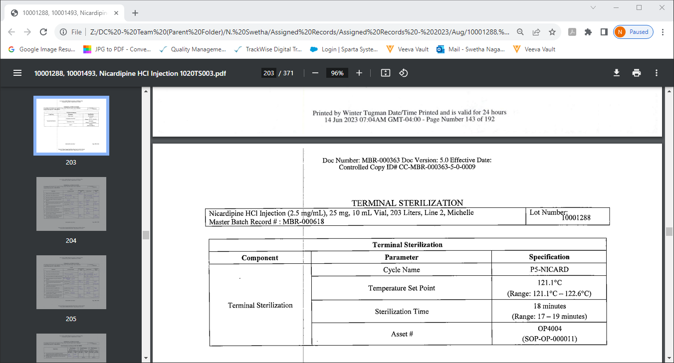
What is Terminal Sterilization
Terminal Sterilization is the process of sterilizing products in their final container. With respect to pharmaceutical manufacturing, Traditional liquid sterile drug products are filled into clean and Sterile primary containers such as Vials, bottles, syringes, cartridges, or bags.

Slide 4
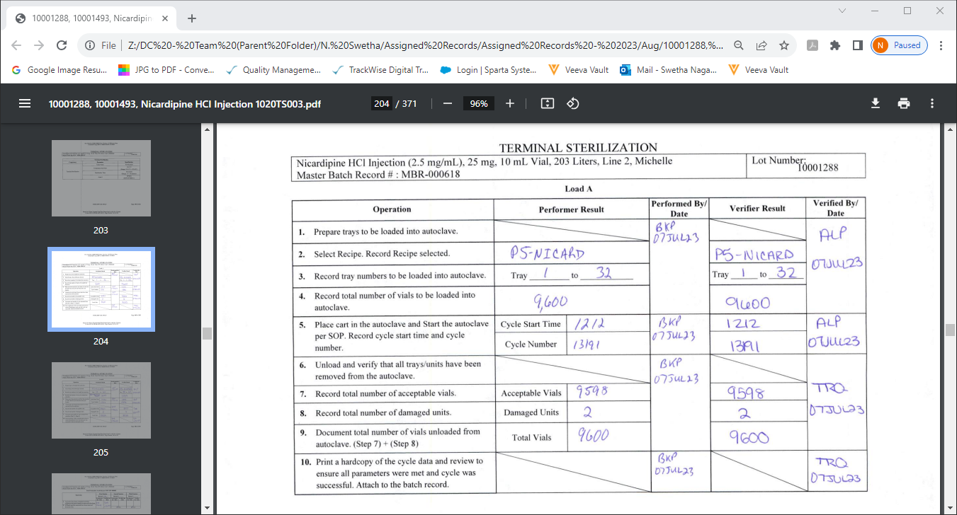

Slide 5
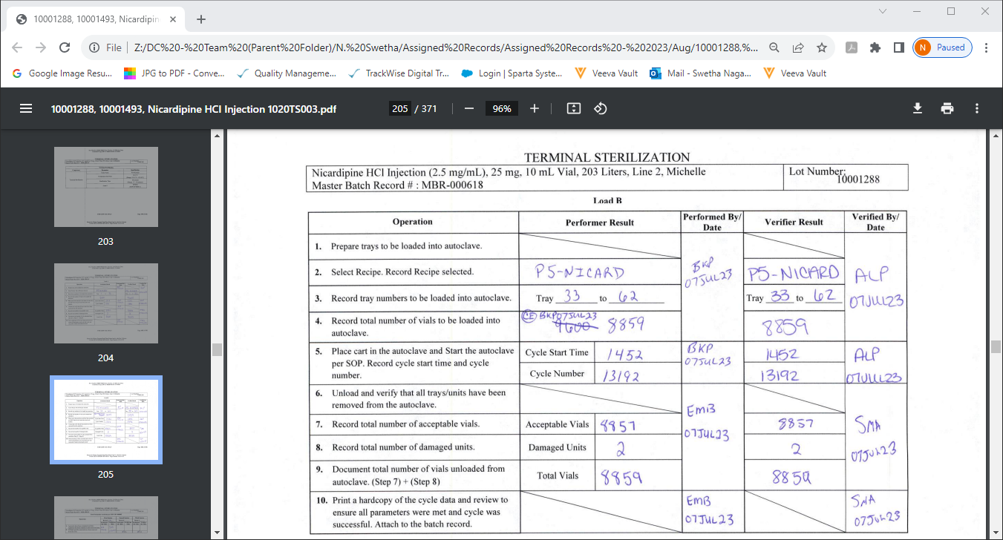

Slide 6
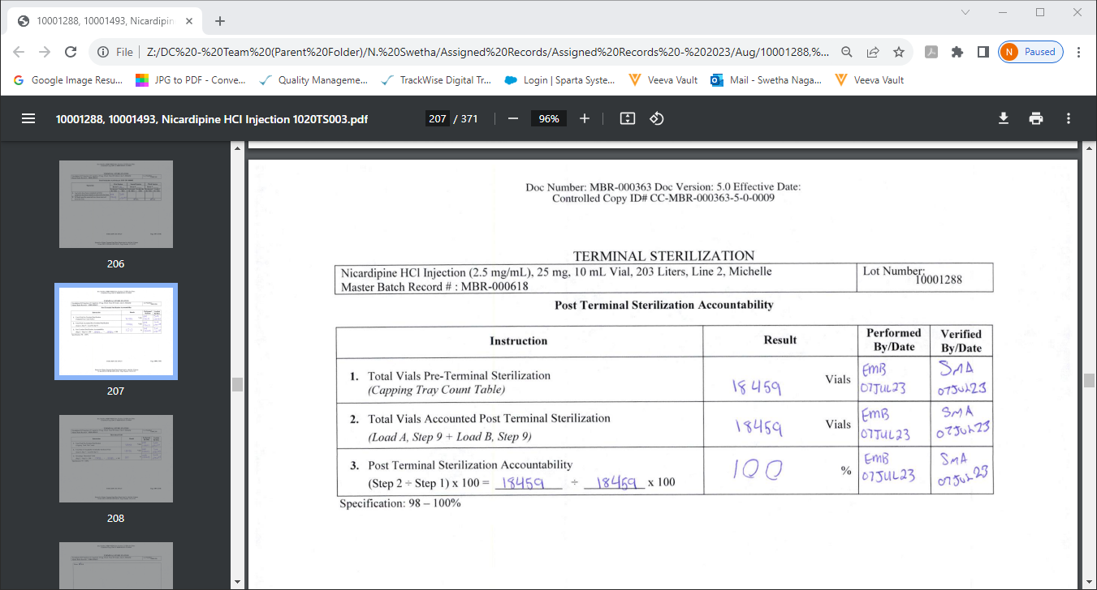

Slide 7
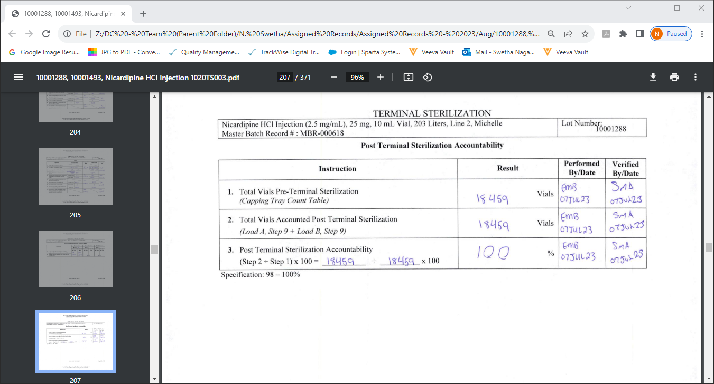
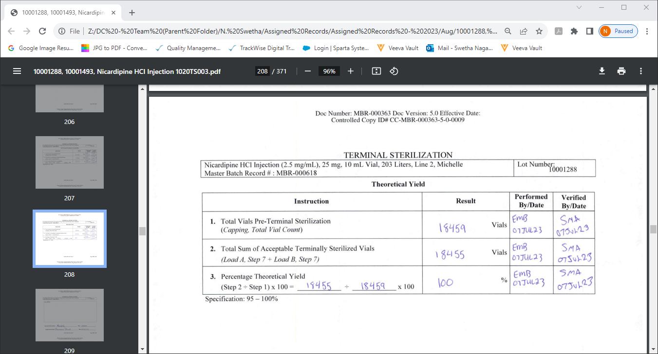

Slide 8


Slide 9
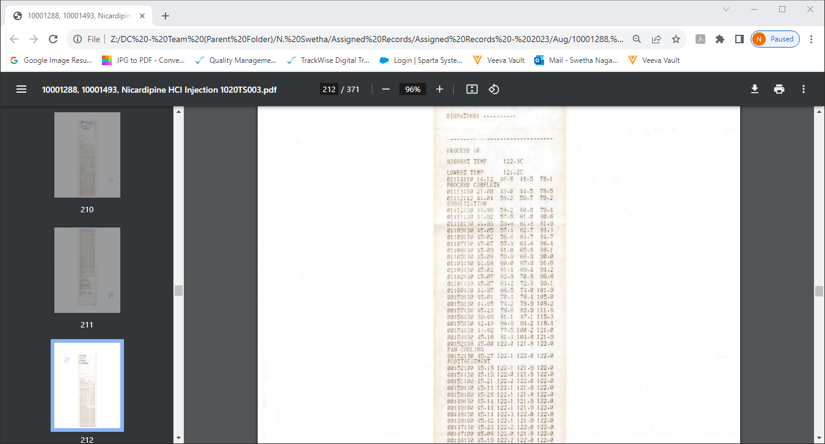

Slide 10
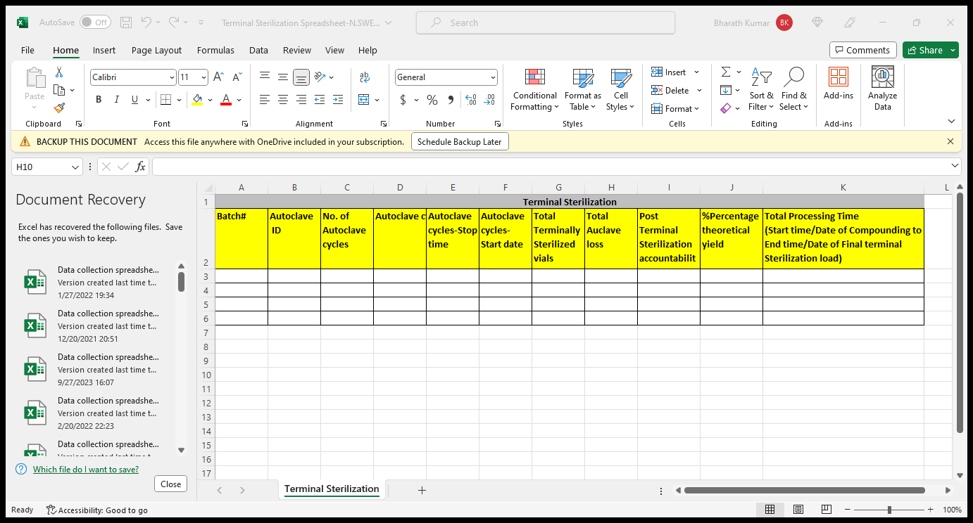

Slide 11
THANK YOU
N.SWETHA

